Slide 1


Titolo presentazione sottotitolo
By Yan Zhuang
YASC
GitHub
Milano, XX mese 20XX

Slide 2
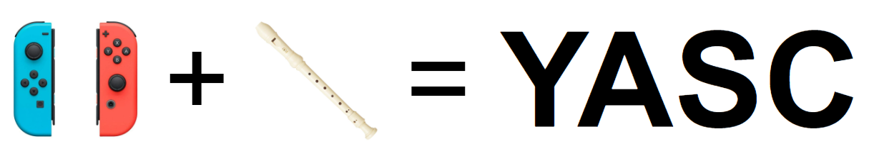
Introduction
The goal of the project is to develop an interactive recorder performance tool, incorporating Joy-Con controllers via a web interface for gesture-based inputs and SuperCollider for sound synthesis.

Slide 3
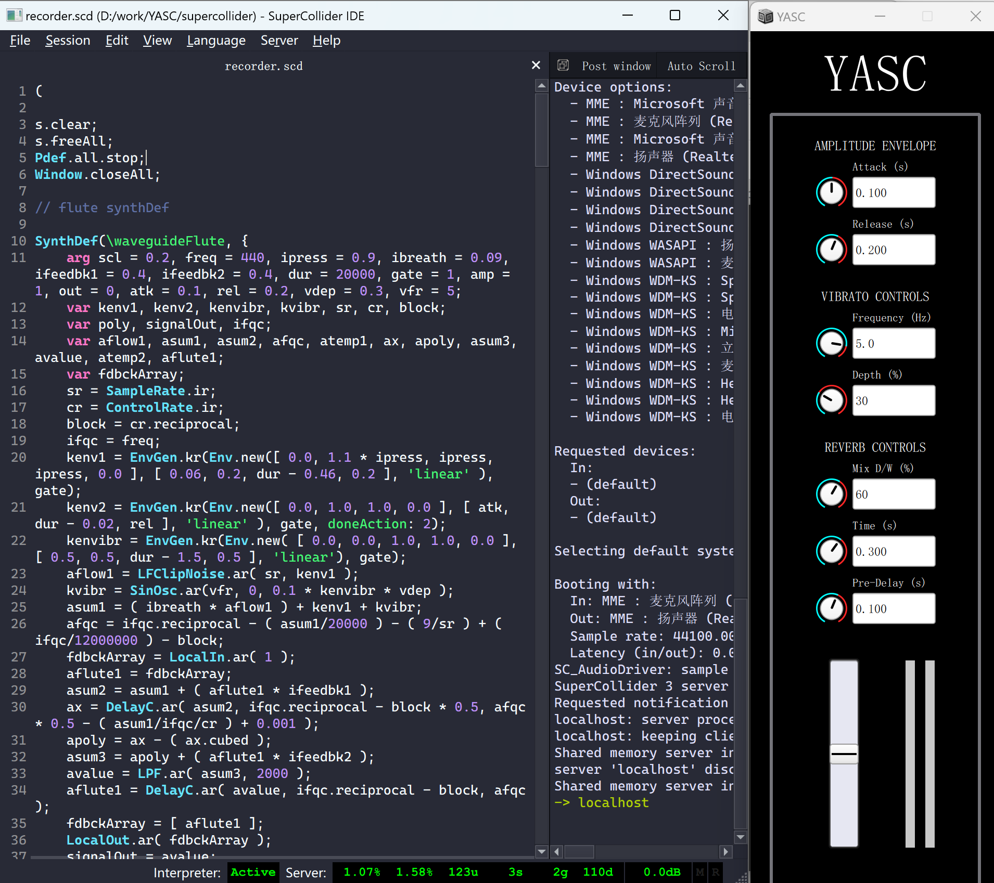
SuperCollider
It's an engine for sound synthesis and algorithmic music composition.
It's a real-time sound-based OOP language.
https://supercollider.github.io

Slide 4
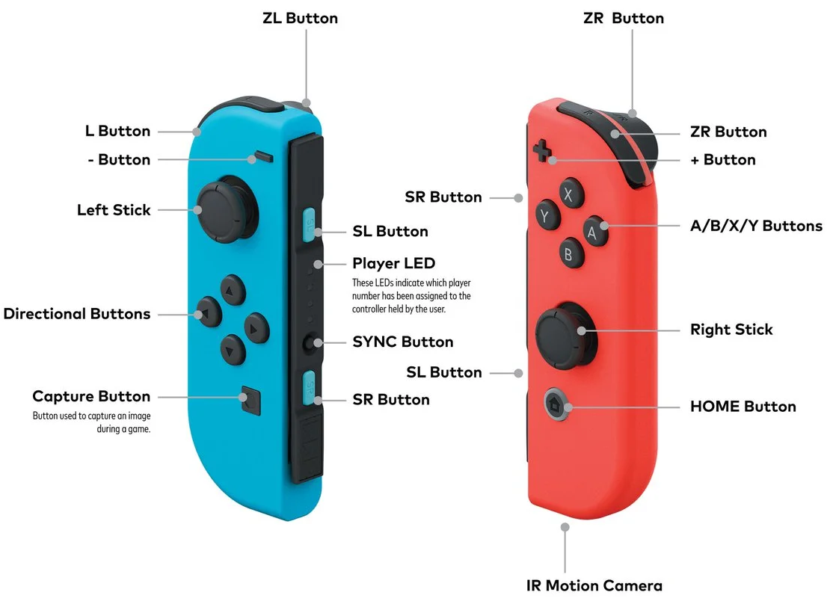
Joy-Con controller
Primary controllers for the Nintendo Switch gaming console.
We could use that to play music.

Slide 5
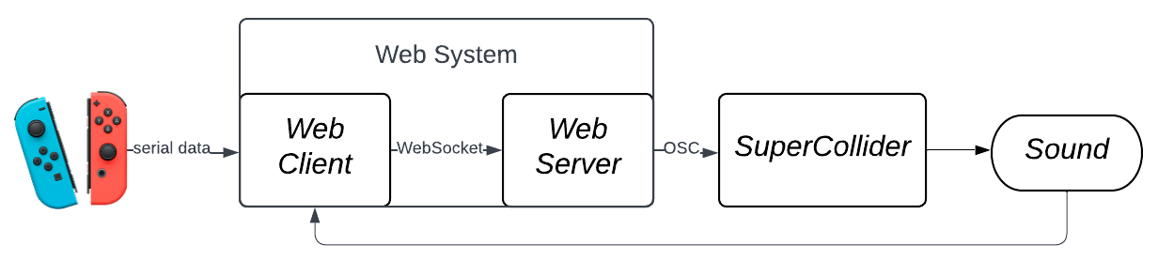
Structure overview
User interaction accomplished with Joy-Con controllers.
Web system acts as main interface.
SuperCollider serves as sound synthesis engine, generating/editing sounds according to the web system commands sent via OSC protocol.
Sound captured by the web system to provide visual feedback.

Slide 6
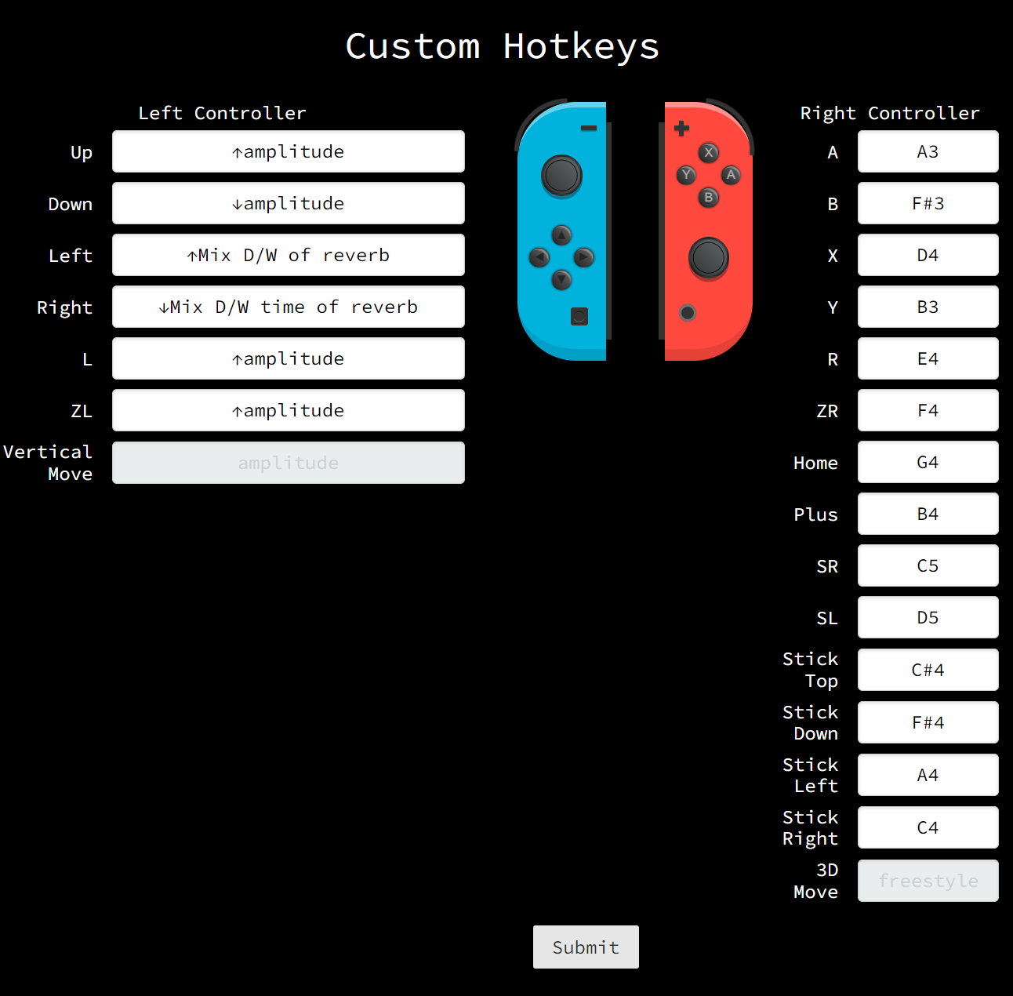
Web system – Map your controller
Through this page, Joy-Con controller can be mapped to different functions.
The left controller is responsible for adjusting parameters in SuperCollider.
The right controller is dedicated to play notes.

Slide 7
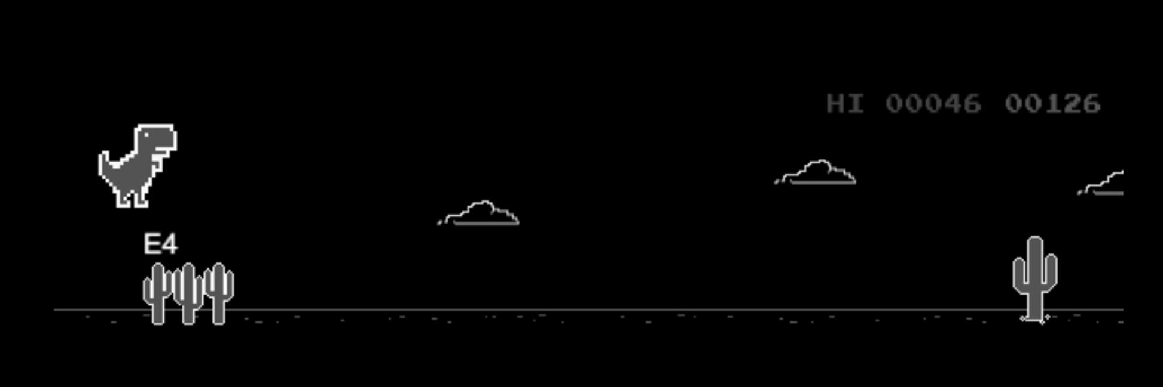
Web system – Train your memory
The dino game page is an interactive training tool designed to help users familiarize with their custom hotkeys.
If you want to jump, press the corresponding hotkey.

Slide 8
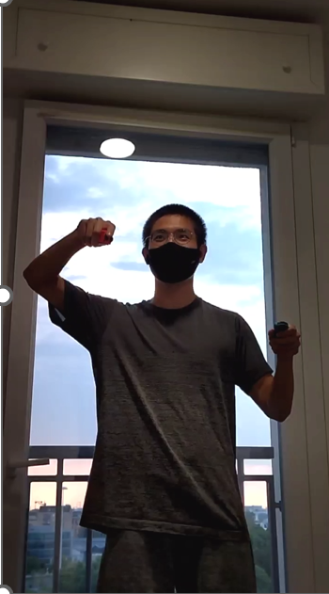
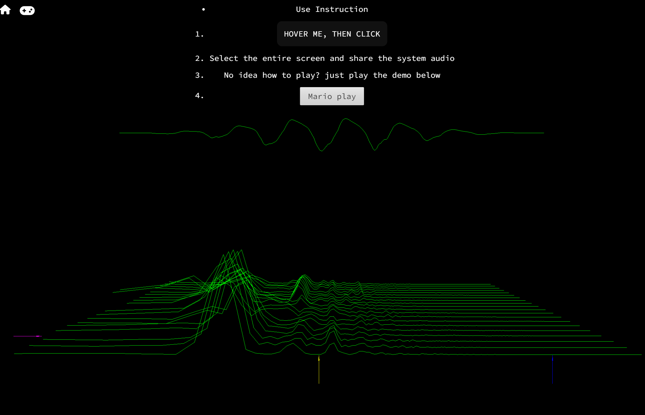
Web system – Play recorder
The performance page provides an immersive audio-visual experience by showing the output sound spectrum.

Slide 9
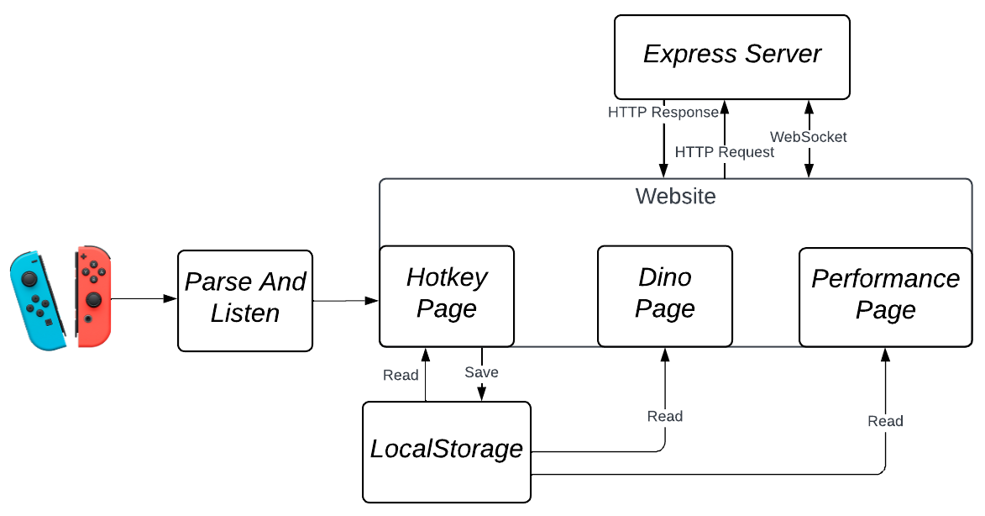
Web system – Implementation
There are three main components which run the web system:

Slide 10
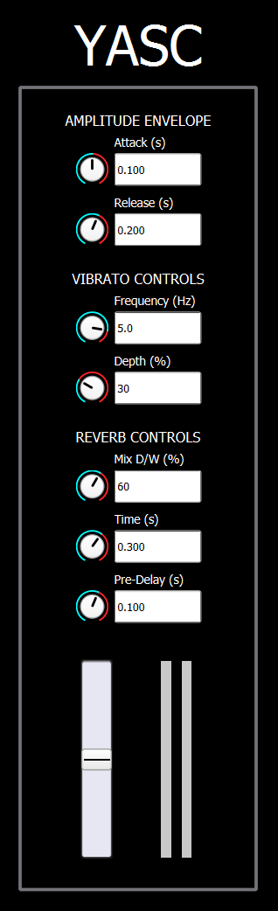
Sound synthesis – GUI
The recorder sound produced in SuperCollider. Users can see the changes made with controllers of some parameters:
Amplitude envelope attack and release time.
Vibrato frequency and depth.
Reverb D/W mix, time and pre-delay.

Slide 11
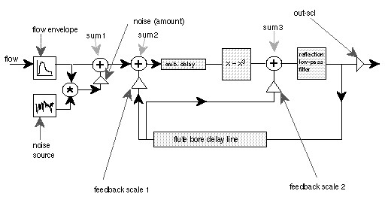
Sound synthesis – Implementation
Perry Cook’s recorder model

Slide 12
Future work
Implement features that allow users to record, save, and replay their performances.
The waveguide model doesn’t behave well at high frequencies. In the short future, multi-modal or multi-dimensional models could be adopted to solve the issue.
Offer more sophisticated sound parameters for users to control in SuperCollider.

Slide 13
Thanks

